Slide 1


ME2115/ME2115E/TME2115 - Mechanics of Machines
Kinetics of rigid bodies
Dr. SHEN Lei (Part I)
Email: shenlei@nus.edu.sg
Tel: 66013813; Office: EA-05-09

Slide 2
Contents
PLANE MOTION OF RIGID BODIES: NEWTON’S 2ND LAW
Introduction
Recap
Free-body diagram
Rigid-body kinematics
Reference-point method for acceleration
Mass moment of inertia
Effective force diagram
Constrained plane motion
Centroidal rotation
Non centroidal rotation
Rolling motion
All will be used in this Chapter !
New

Slide 3
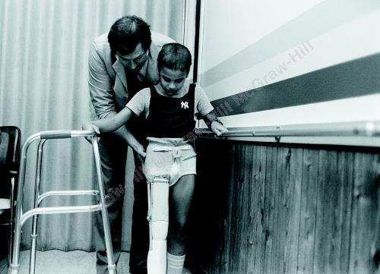
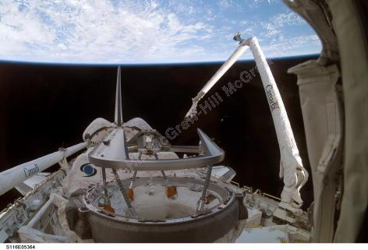
Introduction: Rigid body kinetics
Early design of prosthetic legs relied heavily on kinetics. It was necessary to calculate the different kinematics, loads, and moments applied to the leg to make a safe device.
The forces and moments applied to a robotic arm control the resulting kinematics, and therefore the end position and forces of the actuator at the end of the robot arm.

Slide 4
Particle kinetics – Newton’s 2nd law
If the resultant force acting on a particle is not zero, the particle will have an acceleration that is proportional to the magnitude of the resultant force and in the direction of this resultant force, i.e.
The constant value is the mass m of the particle.
So, Newton’s 2nd Law may be given by
When a particle is subjected simultaneously to several forces, it should be
Force
Mass
Linear motion

Slide 5
Rigid body kinetics
In this chapter, we will be concerned with the kinetics of rigid bodies, i.e., relations between the forces acting on a rigid body, the shape and mass of the body, and the linear/angular motion produced.
Angular mass
(mass moment of inertia)
Mass
Angular acceleration
Force
(TRANSLATION)
Force induced moment
(ROTATION)
Linear acceleration

Slide 6
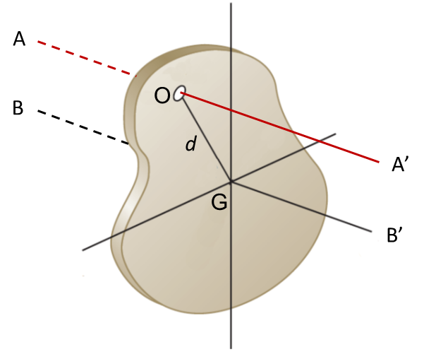
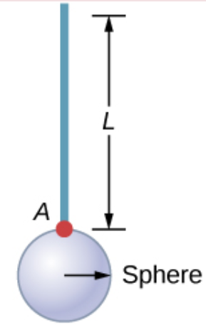
Introduction: Plane motion of rigid bodies
Results of this chapter will be restricted to:
plane motion of rigid bodies
rigid bodies consisting of plane slabs or bodies which are symmetrical with respect to the reference plane (having a mirror symmetry).
Mirror plane
Note: motion is two-dimensional, but the rigid body may not be a 2D thin plate. For example, a rod is welded to a solid sphere at point A.
B
O
Plane view

Slide 7
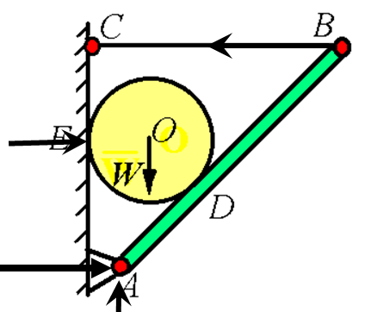
Recap: L2 - Drawing F.B.D
Steps of drawing F. B. D:
Isolate the body of interest (to be a free body)
Draw your axis system (Cartesian, polar…)
Draw all non-constrained applied forces first, such as weight, wind force, applied forces
Draw all constrained forces based on the supports and connections (see F.B.D tables)
Draw appropriate dimensions (angles and distances)
Remove the internal forces of two free bodies if have
F.B.D

Slide 8
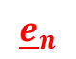
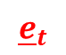
Recap: L3 – Kinematics of particles
Components of curvilinear motion
To resolve vector a into components (scalars) for further calculations
Curvilinear motion (2D motion):
Rectangular
Cartesian Coordinates
Tangential & normal
For 2D planar motion, one can choose any reference coordinates for convenience, which would not change the final results.
$${\underline{e}}_{t}$$
j
$${\underline{e}}_{n}$$
.
i
motion of projectiles
Circular motion
(R components)
(T&N components)

Slide 9
Recap: L4 - Kinematics of rigid bodies
O
r
Pure rotation
a_{A}
General plane motion = Translation with A + Rotation about A.
A
Reference-point method: taking A as the reference point
a_{A}
Translational
(absolute)
Rotational
(relative)
B
Normal
Tangential
General motion

Slide 10
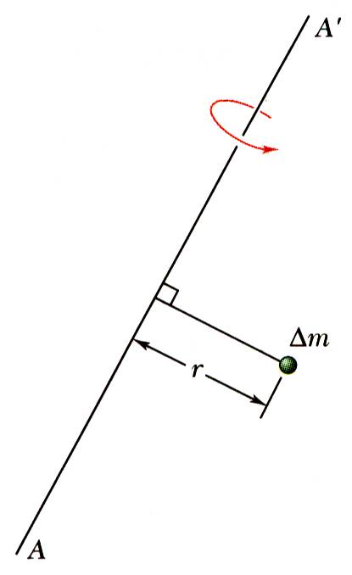
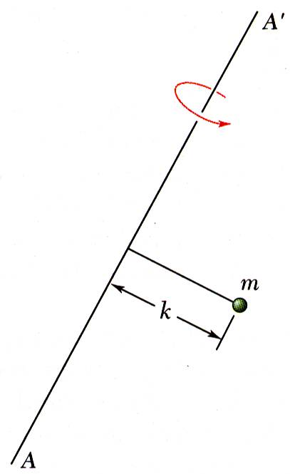
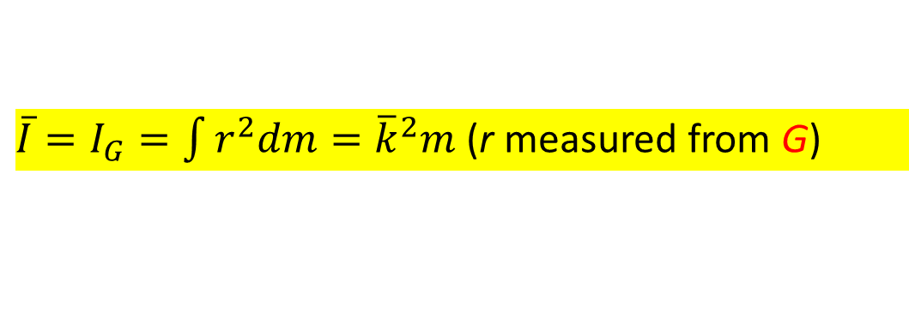
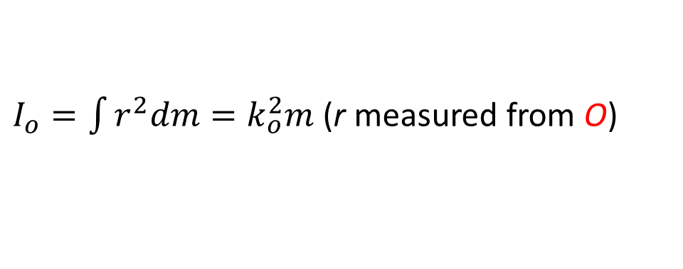
Recap: L5 - Mass moment of inertia
The general definition for I with respect to the perpendicular axis through point O (not necessarily the mass centre) is
G
dm
$I_{o}=\int{r^{2}dm=k_{o}^{2}m}$ (r measured from O)
O
r
Δm: mass of an arbitrary particle
k_{o} is the radius of gyration or effective distance for a concentrated point mass, m=ΣΔm)
The radius of gyration k represents, therefore, the distance at which the entire mass of the body should be concentrated if its 2nd moment of inertia with respect to AA’ is to remain unchanged.
If the reference point is the mass centre G, we use the notation $\overline{I}$, i.e., the mass moment of inertia about the centroidal axis is
${\overline{I}=I}_{G}=\int{r^{2}dm={\overline{k}}^{2}m}$ (r measured from G)
For common geometric shapes, I_{G} can be found in the Table in L5 notes
Notes:
Three ways to calculate I (by given K, by integral, by Table)

Slide 11
*Effective force diagram
The effect of the resultant on a rigid body is equal to effective forces on all particles.
F₂
F₃
Force effect only
G
Free Body Diagram
=
G
EffectiveForce Diagram
m_{i}a_{i}
=
G
F₁
F₄
Focus on resultant force first
Eq. 6.1: Resultant = total mass times linear acceleration of CG

Slide 12
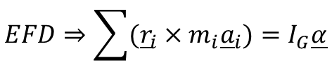
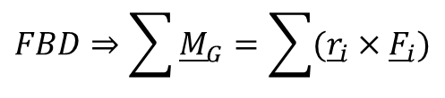
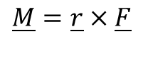
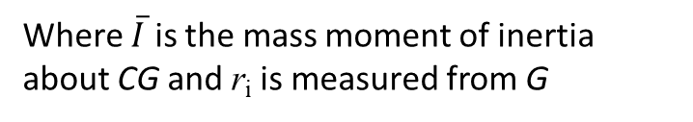
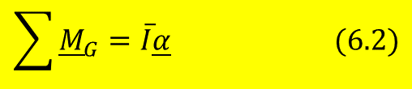
Effective force diagram
Now focus on resultant moment
Taking moment about mass centre G: (recall )
$$\underline{M}=\underline{r}×\underline{F}$$
$$FBD⇒\sum{{\underline{M}}_{G}}=\sum{({\underline{r}}_{i}×{\underline{F}}_{i})}$$
$$EFD⇒\sum{({\underline{r}}_{i}×m_{i}{\underline{a}}_{i})}=I_{G}\underline{α}$$
$$\sum{{\underline{M}}_{G}}=\overline{I}\underline{α} (6.2)$$
Where $\overline{I}$ is the mass moment of inertia about CG and r_{i} is measured from G
Moment effect only
F₂
F₃
G
Free Body Diagram
=
G
EffectiveForce Diagram
=
G
m_{i}a_{i}
F₁
F₄
Eq. 6.5: Moment resultant = mass moment of inertia times the angular acceleration

Slide 13
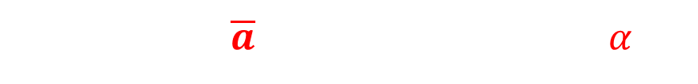
* In summary
Force + Moment
The effective force system of a rigid body in plane motion can be represented by
a linear vector attached at G in the plane, and
a couple vector normal to the plane.
Sign convention: +i, +j, +k (CCW)
y
F₂
F₃
Resolve into x and y
components
G
=
G
=
G
x
F₁
F₄
F.B.D
E.F.D
E.F.D
Motion of a rigid body in plane motion is completely defined by the force resultant and moment resultant about G of the external and effective forces as:
Kinematics: $\overline{a}=a_{ref}+rω^{2}e_{n}+rαe_{t}$

Slide 14
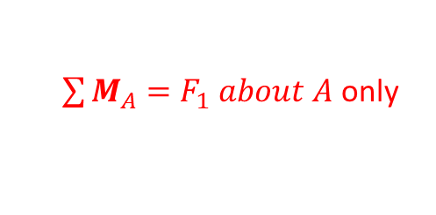
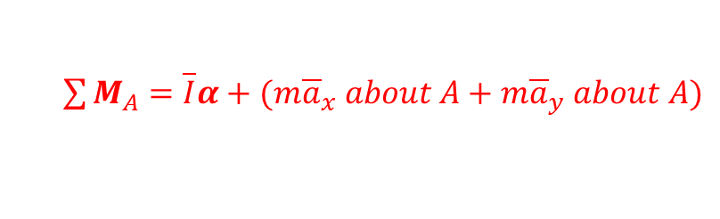
In summary
Force + Moment
y
A
F₃
A
F₂
G
=
G
x
F₁
F₄
F.B.D
E.F.D
Note 1: Not necessarily to sum moment about G always. For example, we can take moment about point A for convenience.
In F.B.D, we now only have one term in the summation as F₂, F₃ and F₄ pass through A.
$\sum{M_{A}}=F_{1} about A$ only
In E.F.D, we, however, have two more terms in the summation as moments of the force ma_{x} and ma_{y} about A are not zero.
$\sum{M_{A}}=\overline{I}α+(m{\overline{a}}_{x} about A+m{\overline{a}}_{y} about A)$
$\overline{I}α$ is sill valid here as the principle of in-plane moment transmissibility.

Slide 15
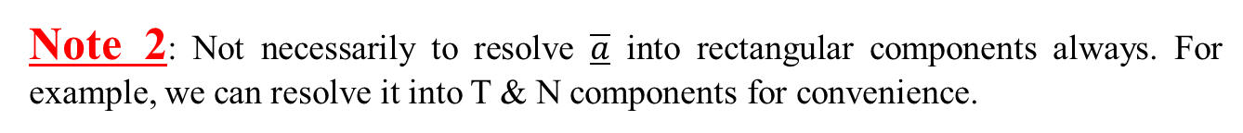
In summary
Force + Moment
F₂
F₃
t
G
=
G
F₁
F₄
n
t
n
F.B.D
E.F.D
Note 2: Not necessarily to resolve $\overline{a}$ into rectangular components always. For example, we can resolve it into T & N components for convenience.

Slide 16
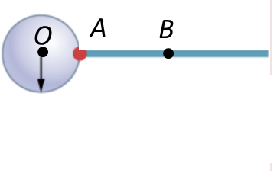
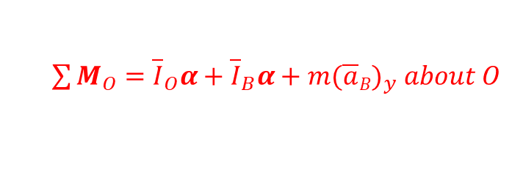
In summary
Force + Moment
y
F₃
F₂
G
=
G
x
F₁
F₄
F.B.D
E.F.D
Note 3: These equations may also be applied to problems involving plane motion of interconnected several rigid bodies by drawing F.B.D and E.F.D for each body and solving the corresponding equations of motion simultaneously.
$\sum{M_{O}}={\overline{I}}_{O}α+{\overline{I}}_{B}α+m({\overline{a}B)}_{y} about O$
The rod is welded on the sphere, making only one rigid body.
A rigid body has only one angular acceleration, α.
The moments of forces Ma_{O} and about O are zero (passing through O)
i
j
Notes:
Alternatively, find mass center G of the composite and then apply the last equation (Note: I_{G} is not easy to be identified)

Slide 17
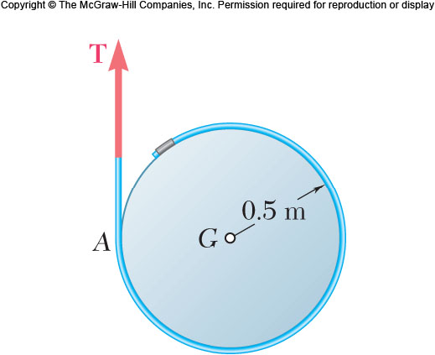
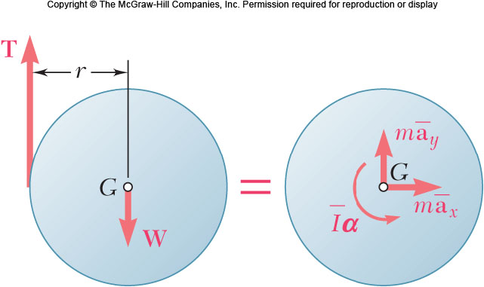
F.B.D vs E.F.D
The free body diagram is the same as you have done in Lecture 2; we will add the effective-force-diagram in our dynamic analysis.
Example:
FBD of a YoYo
y
F.B.D
x
Include your positive z-axis direction by right-hand rule (CCW), too.

Slide 18
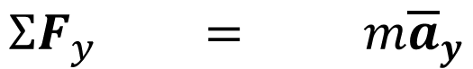
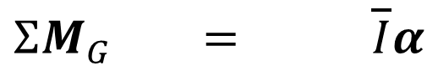
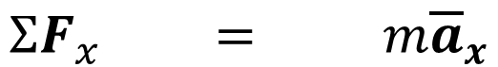
F.B.D vs E.F.D
Put the inertial terms for the body of interest on the E.F.D.
1. Isolate the body of interest (free body)
2. Draw in $m\overline{a}$ of CG; if direction is unknown, do this in the positive direction according to your chosen axes. For rigid bodies, also include the rotational term, $\overline{I}α$
Example:
EFD of a YoYo
Set
FBD = EFD
Get
3 scalar equations
E.F.D
y
$$ΣF_{x} = m{\overline{a}}_{x}$$
x
$$ΣF_{y} = m{\overline{a}}_{y}$$
$$ΣM_{G} = \overline{I}α$$
F.B.D
E.F.D

Slide 19
F.B.D vs E.F.D
Due to different supports and connections, the FBD of the same rigid body may be different.
However, EFD is independent to the supports and connections. Thus, it is very easy to draw EFD of a rigid body if its CG is located. [see Examples 1-3]
y
G
x
j
EFDs like this always
i

Slide 20
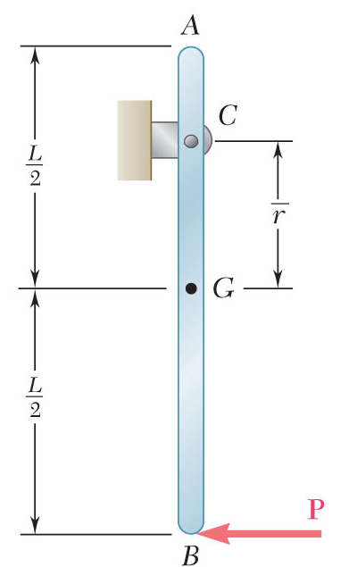
Example 1
Draw the FBD and EFD for the bar AB of mass m. A known force P is applied at the bottom of the bar.

Slide 21
Example 1 (solution)
1. Isolate body
y
2. Axes
C_{y}
3. Non-constrained forces
A
x
4. Replace supports with constrained forces
C
C_{x}
5. Dimensions
L/2
6. Kinetic E.F.D
r
G
G
L/2
mg
B
P

Slide 22
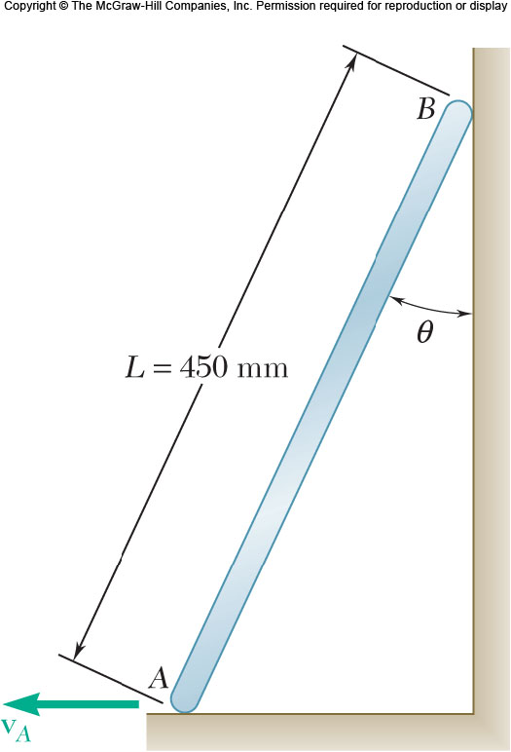
Example 2
A uniform slender bar AB of length L slides down the wall as shown. The wall and floor are both rough. Draw the FBD and EFD for the bar.

Slide 23
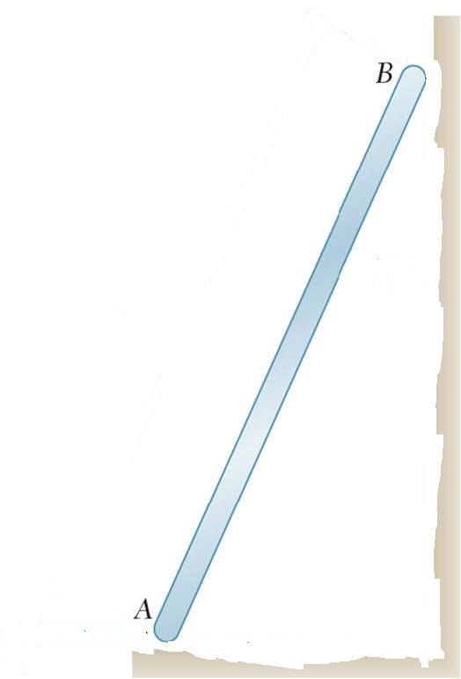
Example 2 (solution)
1. Isolate body
3. Non-constrained forces
5. Dimensions
2. Axes
4. Replace supports with constrained forces
6. E.F.D
N_{B}
θ
F_{B}
=
W
y
F_{A}
x
N_{A}

Slide 24
Example 3
B
A uniform slender bar AB of length L hangs by a string as shown. The surface of the ramp is rough. Draw the FBD and EFD for the bar.
A

Slide 25
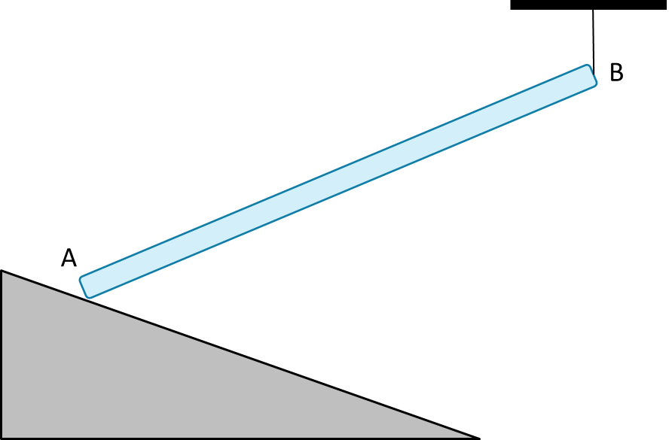
Example 3 (solution)
1. Isolate body
3. Non-constrained forces
5. Dimensions
2. Axes
4. Replace supports with constrained forces
6. E.F.D
F_{B}
=
θ
W
F_{A}
y
N_{A}
θ
x

Slide 26
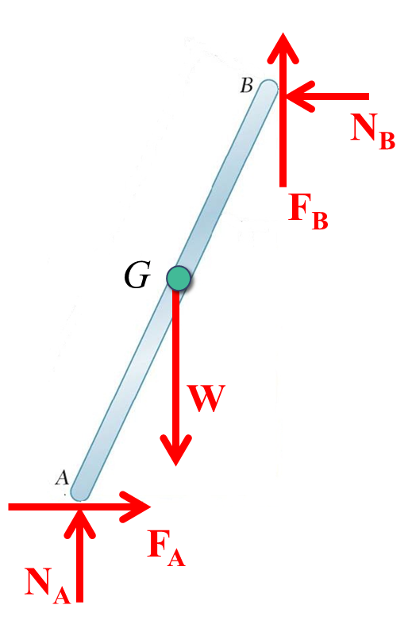
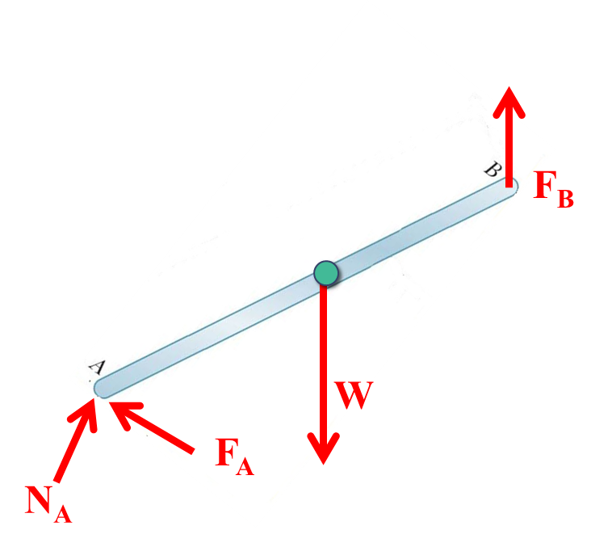
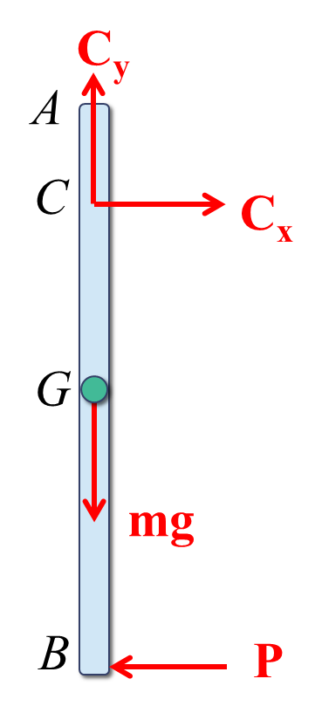
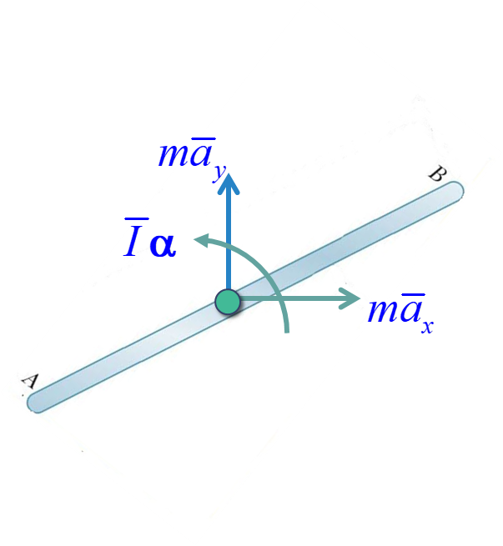
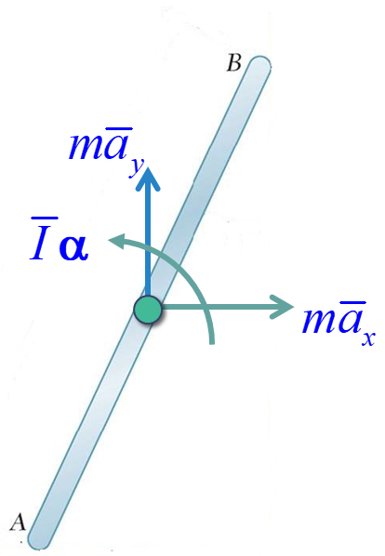
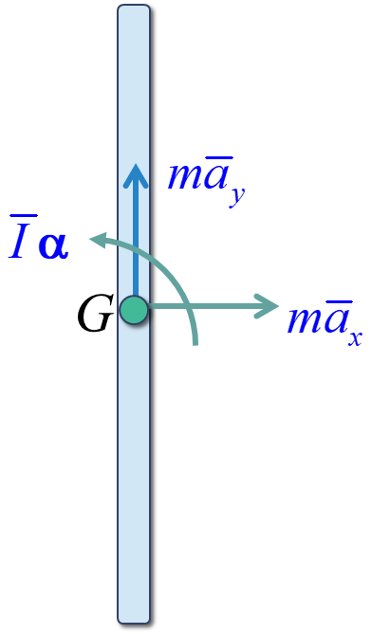
Comparison of Examples 1-3
Different
FBDs
Same
EFD
G
G

Slide 27
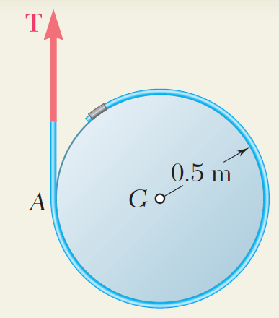
Example 4
SOLUTION:
Draw the free-body-diagram equation expressing the equivalence of the external and effective forces on the disk.
Solve the three corresponding scalar equilibrium equations for the horizontal, vertical, and angular accelerations of the disk.
A cord is wrapped around a homogeneous disk of mass 15 kg. The cord is pulled upwards with a force T = 180 N.
Determine: (a) the acceleration of the center of the disk, and (b) the angular acceleration of the disk.

Slide 28
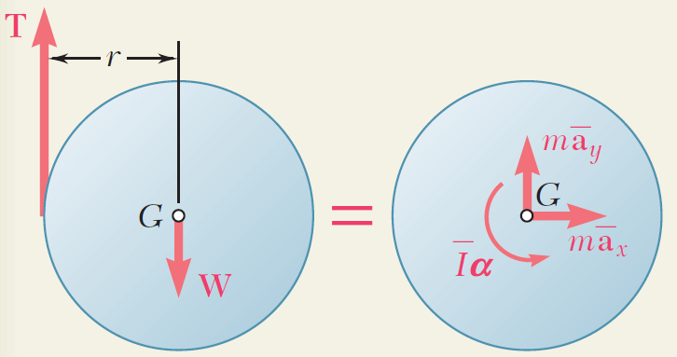
Example 4 (solution)
SOLUTION:
Draw the free-body-diagram equation expressing the equivalence of the external and effective forces on the disk.
Solve the three scalar equilibrium equations.
j
k
i

Slide 29
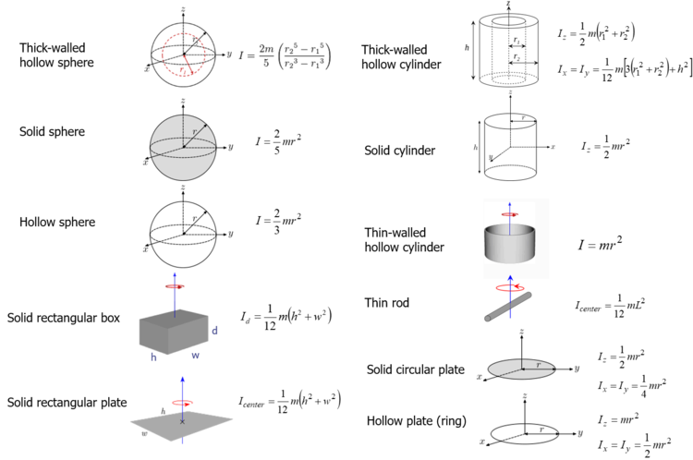
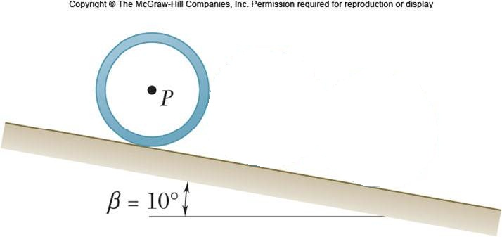
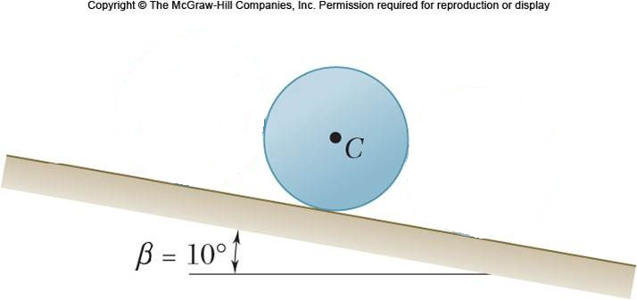
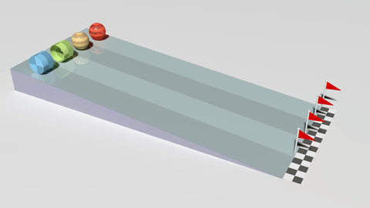
Conceptual question
The thin pipe P and the uniform cylinder C have the same outside radius and the same mass. If they are both released from rest, which of the following statements is true?
The pipe P will have a greater acceleration
The cylinder C will have a greater acceleration
The cylinder and pipe will have the same acceleration

Slide 30
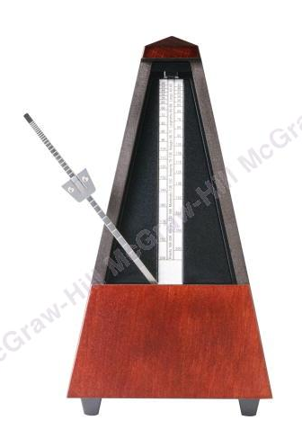
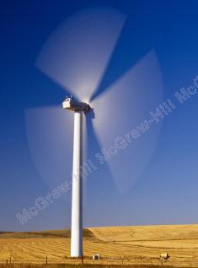
*Constrained plane motion
The forces at the bottom of the pendulum depend on the pendulum mass and mass moment of inertia, as well as the pendulum kinematics.
The forces one the wind turbine blades are also dependent on mass, mass moment of inertia, and kinematics.

Slide 31
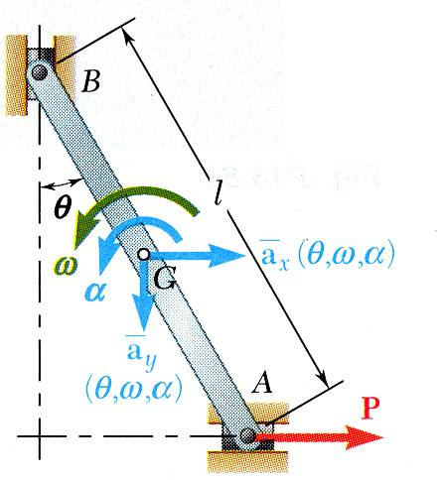
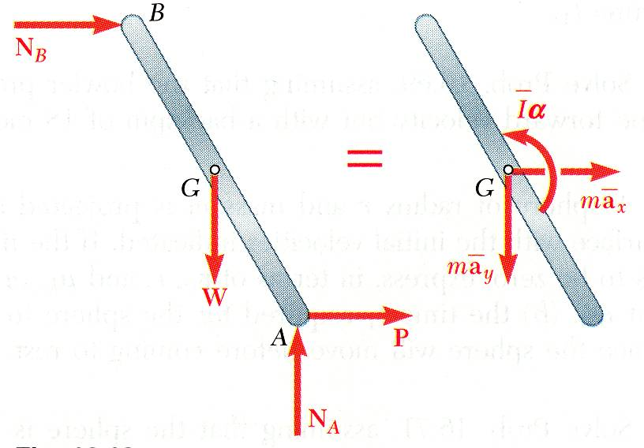
* Constrained plane motion
Constrained plane motion: motions with definite relations between the components of acceleration of the mass centre and the angular acceleration of the body (definite relations between a_{G} and α).
Solution of a problem involving constrained plane motion begins with a kinematic analysis.
* A kinematic analysis is first to establish kinematic relations between a_{G} and α
e.g., given θ, ω, and α as shown, find P, N_{A}, and N_{B}. - kinematic analysis yields in terms of θ, ω, and α
2 equations
- application of FBD=EFD yields P, N_{A}, and N_{B}.
3 equations for 3 unknowns
FBD = EFD

Slide 32
* Constrained plane motion – Special cases
Three special cases:

Slide 33
* Constrained plane motion
Non-centroidal rotation: motion of a body is constrained to rotate about a fixed axis that does not pass through its mass center.
G
G
=
O
O
0
Parallel axis theorem
Note: Parallel axis theorem is not applicable if the rotation is not about a fixed axis/point!!!

Slide 34
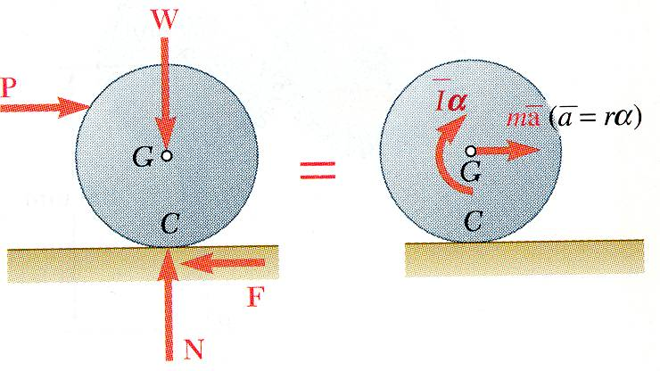
Constrained plane motion
Special case (3): rolling motion
Kinematics of rolling motion
For a balanced disk constrained to roll without sliding,

Slide 35
Example 5
O
Kinematics:
G
Kinetics:
(Parallel axis theorem)
L
G
=
(Do practice: to set up kinetic equations using G
Obtain the same answers

Slide 36
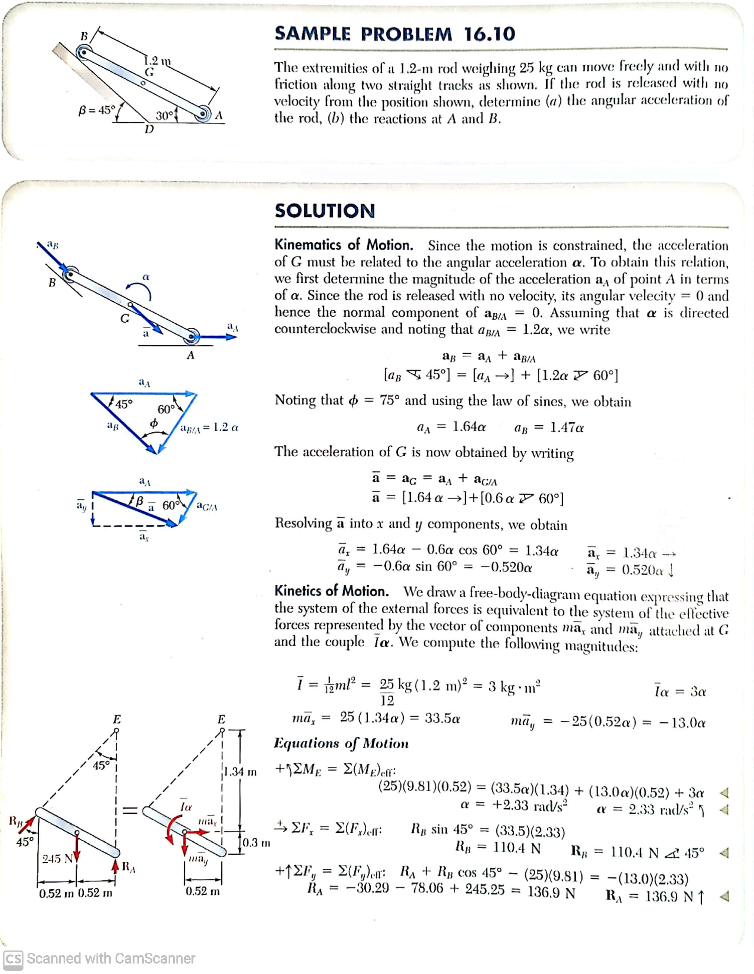
*Example 6
SOLUTION:
Based on the kinematics of the constrained motion, express the accelerations of A, B, and G in terms of the angular acceleration.
Draw the free-body-equation for the rod, expressing the equivalence of the external and effective forces.
The extremities of a 1.2 m rod weighing 25 kg can move freely and with no friction along two straight tracks. A and B are two rollers. The rod is released with no velocity from the position shown.
Determine: a) the angular acceleration of the rod, and b) the reactions at A and B.
Solve the three corresponding scalar equations for the angular acceleration and the reactions at A and B.

Slide 37
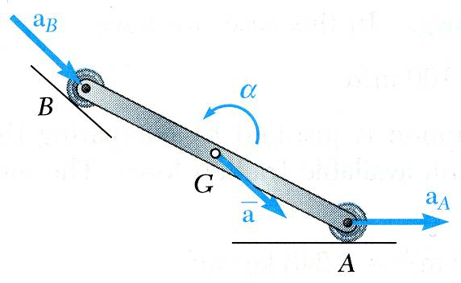


Example 6 (solution)
Kinematics: find the relation between a_{G} and α

Slide 38
Example 6 (solution)
Kinetics:
F.B.D = E. F. D
F.B.D = E. F. D

Slide 39

Interconnected rigid bodies as a whole
(a)
(b)
A rod is welded to a solid sphere at point A, rotating about pivot C
α
C
ω
B
A slender rod AB and a slender rod BC are connected by a pin at B and by the cord AC. The assembly can rotate in a vertical plane under the combined effect of gravity and a couple M applied to rod BC.
Plane view
Method: Application of FBD=EFD on each part
Notice: The angular velocity and angular acceleration are the same for each part!
The linear velocity and acceleration of the pivot are zero.

Slide 40

*Example 7
SOLUTION:
Draw the free-body-equation for AOB, expressing the equivalence of the external and effective forces.
Evaluate the external forces due to the weights of gear E and arm OB and the effective forces associated with the angular velocity and acceleration.
The portion AOB of the mechanism is actuated by gear D and at the instant shown has a clockwise angular velocity of 8 rad/s and a counterclockwise angular acceleration of 40 rad/s².
Determine: a) tangential force exerted by gear D, and b) components of the reaction at shaft O.
Solve the three scalar equations derived from the free-body-equation for the tangential force at A and the horizontal and vertical components of reaction at shaft O.

Slide 41

Example 7 (Solution)
SOLUTION:
Draw the free-body-equation for AOB.
Evaluate the external forces due to the weights of gear E and arm OB and the effective forces.

Slide 42
Example 7 (solutions)
Solve the three scalar equations derived from the free-body-equation for the tangential force at A and the horizontal and vertical components of reaction at O.

Slide 43




* Example 8 (past-year exam question)
ω
α
${\overline{a}}_{x}$=0
$${\overline{a}}_{y}=0$$
Identify:
The whole rigid body (disk+rod) has only one angular velocity ω and angular acceleration α
Point C of disk is fixed. Thus, ${\overline{a}}_{disk}=0$
Application of kinetics on disk and rod separately

Slide 44




Example 8 (Solution)
Kinematics:
α
ω
140 mm
G
$${\overline{a}}_{n}$$
Kinetics:
$${\overline{a}}_{t}$$

Slide 45





Example 8 (Solution)
W_{disk}
W_{rod}
I_{disk}α
I_{rod}α
G
=
G
C_{x}
${m_{C}\overline{a}}_{x}$=0
$${m_{AB}\overline{a}}_{n}$$
$${m_{AB}\overline{a}}_{t}$$
C_{y}
$${m_{C}\overline{a}}_{y}=0$$
F.B.D
E.F.D
Note: a_{t}=|CG|α; a_{n}=|CG|ω²

Slide 46

Example 8 (Solution)
W_{disk}
W_{rod}
I_{disk}α
I_{rod}α
G
=
G
C_{x}
${m_{C}\overline{a}}_{x}$=0
$${m_{AB}\overline{a}}_{n}$$
$${m_{AB}\overline{a}}_{t}$$
C_{y}
$${m_{C}\overline{a}}_{y}=0$$
F.B.D
E.F.D

Slide 47
Constrained plane motion - Rolling motion
P
W
G
=
G
C
F
C
N

Slide 48
Constrained plane motion - Rolling motion

Slide 49

Example 9 (for practice)
SOLUTION:
Draw the free-body-diagram equation expressing the equivalence of the external and effective forces on the sphere.
Solve the three corresponding scalar equilibrium equations for the normal reaction from the surface and the linear and angular accelerations of the sphere.
A uniform sphere of mass m and radius r is projected along a rough horizontal surface with a linear velocity v₀. The coefficient of kinetic friction between the sphere and the surface is μ_{k}.
Determine: linear and angular acceleration.

Slide 50



Example 9 (solution)
SOLUTION:
Draw the free-body-diagram equation expressing the equivalence of external and effective forces on the sphere.
Solve the three scalar equilibrium equations.
The position sense is chosen to the right for $\overline{a}$ and clockwise for $α$.
NOTE: As long as the sphere both rotates and slides, its linear and angular motions are uniformly accelerated.
Notes:
The external forces acting on the sphere consist of the weight W, the normal reaction N, and the friction force F. Since the point of sphere in cotact with the surface is sliding to the right, the friction force F is directed to the left. While the sphere is sliding, the magnitude of the friction force is F=uN.

Slide 51
Example 10
G
r
R
P
G
the direction of

Slide 52
Example 10 (Solution)
W
G
=
G
FBD
C
C
EFD
F
N
+
+
+

Slide 53
Example 10 (Solution)
W
=
G
C
F
C
N

Slide 54


Summary
A
=
A
G
G
$$\underline{\text{Vector} \text{e}\text{quations} \text{of} \text{motion}}\text{: }$$
$\text{Linear}\text{: }\sum{\underline{F}=m\underline{\bar{a}} }$
$$\text{Angular}\text{: }\sum{{\underline{M}}_{G}} = \bar{I}\underline{α} \\ \text{Note}\text{: }\text{Vector} m\underline{\bar{a}} \text{is} \text{attached} \text{at} \text{G} \text{and} \bar{I} \text{is} \text{with} \text{respect} \text{to} \text{G}\text{.} \\ \text{Plane} \text{motion}\text{: }Three \text{s}\text{calar} \text{equations} \text{are} \\ \sum{F_{x}}=m{\bar{a}}_{x} \\ \sum{F_{y}}=m{\bar{a}}_{y} \\ \sum{M_{G}}=\bar{I} α$$
(6.4)
(6.5)
Note 2: Not necessarily G,
Can be arbitrary point A.
Constrained plane motion: need to consider the kinematics as well
$\overline{a}=a_{ref}+rω^{2}e_{n}+rαe_{t}$

Slide 55
Summary
Special cases:
(1)
(2)
(3)
(4)

Slide 56
The END

Slide 57
Extra examples
For practice if time is not available

Slide 58


Q4
Identify:
Dimensions are given => AB and disk are rigid bodies, not particles
Mass are given => kinetic problem, not kinematics
A problem of kinetics of two connected rigid bodies
FBD/EFD of rigid body 1 + FBD/EFD of rigid body 2
Kinematic analysis + kinetic analysis

Slide 59




Q4 (solution)
Execute:
Kinematics analysis:
(find relationship between a and α)
Two rigid bodies: a disk and rod.
(Part 1) C is the mass centre of the disk. Its linear acceleration is zero as it is fixed.
$${\overline{a}}_{C}=0⇒ {\overline{a}}_{n}={\overline{a}}_{t}=0$$
(Part 2) G is the mass centre of the rod. Its linear acceleration components are

Slide 60



Q4 (solution)
Kinetics analysis:
Mass moment of inertia (Given in the table)
For disk C :
For rod AB :
CA

Slide 61


Q4 (solution)
M(a_{c})_{n}=0
M(a_{c})_{t}=0
C is fixed

Slide 62


Q4 (solution)
M(a_{c})_{n}=0
M(a_{c})_{t}=0

Slide 63



Q4
Evaluate:
1) Because disk C and rod AB are rotating about fixed point C, we can use parallel axis theorem to calculate the moment of inertia about point C.
=
G
Thus, the last two terms of R.H.S in the equation in slide 17 can be replaced by
$${\left(I_{AB}\right)}_{C}=I_{G}+m(CG)^{2}$$
$$m_{AB}{\overline{a}}_{t}\left(0.14m\right){+ \overline{I}}_{AB}∙α={\left(I_{AB}\right)}_{C}∙α$$
2) Where is the mass centre of the whole rigid-body system?

Slide 64

Example 1
A drum of 4 cm radius is attached to a disk of 8 cm radius. The combined drum and disk had a combined mass of 10 kg. A cord is attached as shown, and a force is applied. The coefficients of static and kinetic friction between the wheel and ground are μ_{s}= 0.25 and μ_{k}= 0.20, respectively. Draw the FBD and EFD for the wheel.

Slide 65


Example 1 (solution)
1. Isolate body
2. Axes
3. Non-constrained forces
4. Replace supports with constrained forces
5. Dimensions
6. Kinetic E.F.D
P
4 cm
=
8 cm
W=10g
y
F
N
x

Slide 66

Example 2
SOLUTION:
Identify: After the wire is cut, all particles of the plate move along parallel circular paths of radius 150 mm. The plate is in curvilinear translational motion, NO rotation!
Draw the free-body-diagram equation expressing the equivalence of the external and effective forces.
The thin plate of mass 8 kg is held in place as shown.
Neglecting the mass of the links, determine immediately after the wire has been cut (a) the acceleration of the plate, and (b) the force in each link.
Resolve into scalar component equations parallel and perpendicular to the path of the mass center.
Solve the component equations and the moment equation for the unknown acceleration and link forces.

Slide 67




Example 2 (solution)
SOLUTION:
Note that after the wire is cut, all particles of the plate move along parallel circular paths of radius 150 mm. The plate is in curvilinear translation, no rotation! i.e., = 0 in E.F.D
Draw the free-body-diagram equation expressing the equivalence of the external and effective forces.
Resolve the diagram equation into T& N components parallel and perpendicular to the path of the mass centre.
FBD
$\overline{I}α$=0
60º
EFD

Slide 68
Example 2 (solution)
Solve the component equations and the moment equation for the unknown acceleration and link forces.
60º

Slide 69




Example 3
D
θ
C
M
A
θ
B
Plate
F_{D}
$$v_{C}$$
t
Pure rotation about D
Magnitude: C_{n} = F_{D}
C_{t} = 0
t
n
$$v_{C}=CD∙ω_{CD}=0.6ω_{CD}$$
M = 180
$$v_{B}$$
t
Pure rotation about A
t
$$v_{B}=AB∙ω_{AB}=0.6ω_{AB}$$
0.6 m
$$θ_{CD}=θ_{AB} →ω_{CD}=ω_{AB}→v_{C}=v_{B}$$
n

Slide 70


Example 3 (solution)
D
θ
C
M
A
θ
B
Plate
$$v_{C}=v_{B}$$
($ρ=∞$)
G
X
v_{C} = v_{B} (same magnitude and
direction)

Slide 71

Example 3 (solution)
Draw the FBD and EFD for the plate.
Note: for convenience, we use T&N components instead.
C_{n}
F.B.D
E.F.D
G
0.6 m
=
G
B_{n}
W
B
0
B_{t}
0.9 m
t
0
0
+
Note: $\sum_{EFD}{{\underline{M}}_{B}}=m{\overline{a}}_{n} about B+m{\overline{a}}_{t} about B+\overline{I}α about B$

Slide 72


Example 4
250 mm
A pulley of mass 6 kg and having a radius of gyration of 200 mm is connected to two blocks as shown. Assuming no axle friction, determine the angular acceleration of the pulley and the linear acceleration of each block.
150 mm
2.5 kg
Solution:
5 kg
Sense of Motion.
Although an arbitrary sense of motion can be assumed (since no friction forces are involved) and later checked by the sign of the answer, we may prefer to determine the actual sense of rotation of the pulley first as shown.
The weight of block B, required to maintain the equilibrium of the pulley when it is acted upon by the 2.5-kg block A, is first determined. We check the moment about G
$$m_{B}g\left(150 mm\right)=\left(2.5 kg\right)g\left(250 mm\right) ⇒m_{B}=4.167 kg$$
Since block B actually weights 5 kg, the pulley will rotate CCW.

Slide 73



Example 4 (solution)
Kinematics
Kinetics
W
2.5 kg
5 kg

Slide 74
Example 5 (practice)
(Radius of gyration)
C
A
B
Kinematics:
Solution
Linear translation
(tangential direction)
C_{y}
C
C_{x}
C
=
W
A
B
A
B
2.4g
2.4g
2.4a_{A}
2.4a_{B}

Slide 75

Example 6
SOLUTION:
Draw the free-body-equation for the sphere, expressing the equivalence of the external and effective forces.
With the linear and angular accelerations related, solve the three scalar equations derived from the free-body-equation for the angular acceleration and the normal and tangential reactions at C.
A sphere of weight W is released with no initial velocity and rolls without slipping on the incline.
Determine: a) the minimum value of the coefficient of friction, b) the velocity of G after the sphere has rolled 10 ft and c) the velocity of G if the sphere were to move 10 ft down a frictionless incline.
Calculate the friction coefficient required for the indicated tangential reaction at C.
Calculate the velocity after 10 ft of uniformly accelerated motion.
Assuming no friction, calculate the linear acceleration down the incline and the corresponding velocity after 10 ft.

Slide 76

Example 6 (solution)
SOLUTION:
Draw the free-body-equation for the sphere, expressing the equivalence of the external and effective forces.
With the linear and angular accelerations related, solve the three scalar equations derived from the free-body-equation for the angular acceleration and the normal and tangential reactions at C.
Kinematic analysis:

Slide 77
Example 6 (solutions)
Solve the three scalar equations derived from the free-body-equation for the angular acceleration and the normal and tangential reactions at C.
Calculate the friction coefficient required for the indicated tangential reaction at C.

Slide 78
Example 6 (solutions)
Solve the three scalar equations derived from the free-body-equation for the angular acceleration and the normal and tangential reactions at C.
Calculate the friction coefficient required for the indicated tangential reaction at C.

Slide 79

Example 7
The uniform rod AB of weight W is released from rest. Assuming that the friction force between end A and the surface is large enough to prevent sliding, determine immediately after release (a) the angular acceleration of the rod, (b) the normal reaction at A, (c) the friction force at A.
SOLUTION:
Draw the free-body-diagram and kinetic diagram showing the equivalence of the external forces and inertial terms.
Write the equations of motion for the sum of forces and for the sum of moments.
“Released from rest” means : v₀ = 0; ω₀ = 0
Apply any necessary kinematic relations, then solve the resulting equations.
“Surface is large enough to prevent sliding” means:
A is at rest during the motion, v_{A} = 0; a_{A} = 0
(pure rotation!)

Slide 80

Example 7 (solution)
SOLUTION: Given: W_{AB} = W, β= 70º
Find: α_{AB}, N_{A}, F_{f}
Draw your FBD and EFD
Set up your equations of kinetic motion
Kinematics and solve (next page)
L/2
=
L/2
W
j
70º
70º
i
F_{f}
Kinetics:
N_{A}
(1)
(2)
(3)

Slide 81
Example 7 (solution)
Set up your kinematic relationships – Find a_{G} and α_{AB} relationship
a_{y}
Using A as the reference point:
L/2
α_{AB}
L/2
a_{x}
Note: a_{A} and ω_{AB} are zero just after releasing
j
70º
i
Realize that you get two equations from the kinematic relationship
(4);
(5)
Now, 5 equations for 5 unknowns, a_{x}, a_{y}, F_{f}, N_{A}, α_{AB}
Substitute into the sum of forces equations

Slide 82
Example 7 (solution)
Substitute the F_{f} and N_{A} into the sum of moments equation
Masses cancel out, solve for α_{AB}
The negative sign means α is clockwise, which makes sense.
Subbing into N_{A} and F_{f} expressions,

Slide 83
Example 8
B
L
Kinematics (analytic method):
A
O
C
0 (just release from rest, no velocity)
G
=

Slide 84
Example 8 (Cont’d)
Kinetics:
C
C
G
=
+
For convenience, we take moment about C to eliminate the terms of A_{y} and B_{x} in F.B.D.

Slide 85


Example 8 (alternative method to find )
Kinematics (reference-point method):
②
②
④
③
③
①
①
④
①=②+③+④
Write in terms of the two component equations,
0
x components:
0
Three unknowns a_{A,} a_{B} and α.
y components:
If ω≠0,
The same as that in the previous slide.
Kinetics: ……

Slide 86
Constrained plane motion - special case 3

Slide 87
Constrained plane motion (special case 3: rolling motion)
P
W
G
=
G
C
F
C
N

Slide 88
Constrained plane motion (special case 3: rolling motion)

Slide 89
Constrained plane motion (special case 3: rolling motion)
P
O
W
=
0
G
N
C

Slide 90


Example 9
75mm
O
x
G
225mm
C
y
Kinematics:
O
G
fixed
Resolve:
$${\overline{a}}_{x}=0.225α−0.3$$
$${\overline{a}}_{y}=0.075α$$

Slide 91
Example 9 (solution)
Kinetics:
G
O
=
x
mg
0.225
y
F
N
Evaluate:

Slide 92

Example 10
Assuming rolling without slipping and therefore, related linear and angular accelerations, solve the scalar equations for the acceleration and the normal and tangential reactions at the ground.
A cord is wrapped around the inner hub of a wheel and pulled horizontally with a force of 200 N. The wheel has a mass of 50 kg and a radius of gyration of 70 mm. Knowing μ_{s} = 0.20 and μ_{k} = 0.15, determine the acceleration of G and the angular acceleration of the wheel.
Compare the required tangential reaction to the maximum possible friction force.
If slipping occurs, calculate the kinetic friction force and then solve the scalar equations for the linear and angular accelerations.

Slide 93

Example 10 (Solution)
SOLUTION:
Draw the free-body-equation for the wheel,.
Assuming rolling without slipping, solve the scalar equations for the acceleration and ground reactions.
Kinematics:
Assume rolling without slipping,

Slide 94

Example 10 (Solution)
Compare the required tangential reaction to the maximum possible friction force.
F > F_{max} , rolling without slipping is impossible.
Calculate the friction force with slipping and solve the scalar equations for linear and angular accelerations.
Without slipping,

